Slide 1
UNIT-VI Security, Standards, Applications and Emerging Technologies Security in Cloud: Cloud security challenges – Software as a Service Security, Common Standards: Developer – Standards for Messaging – Standards for Security, End user access to cloud computing, Mobile Internet devices and the cloud. Internet of Things: applications, challenges, Integration of Cloud with IoT: Applications, challenges and limitations, Fog/Edge computing: applications and limitations.

Slide 2
Learning Outcomes
Understand security objectives in cloud environment
Explain the security services of cloud computing
Explain the security techniques used in virtual machine (VM)
Describe challenges of cloud security
Comprehend physical security of cloud computing
Describe IoT
Discuss CoT
Understand Fog and Edge Computing

Slide 3
Introduction
Cloud computing offers several benefits to users and organizations, in terms of capital expenditure and savings in operational expenditure.
Despite the existence of such benefits, there are some obstacles that place restrictions on the usage of cloud computing.
Security is a major issue that is always considered. The lack of this vital feature results in the negative impact of the computing archetype thus resulting in personal, ethical, and financial harm.

Slide 4
Continue..
A reliable cloud computing system will defend data in operation with applications and hypervisors against illegal access to information and apply encryption to defend sensitive data.
Cloud computing has issues related to security, which is why cloud users are always not sure about the security of data that they maintain on the cloud.
Cloud users worry about the threats associated with maintaining data on the cloud.

Slide 5
Security challenges
Users are unaware of the exact location of their sensitive data, because the Cloud Service Providers(CSP's) maintain data centers in geographically distributed locations resulting in several security challenges and threats.
The traditional security techniques such as firewalls, host-based antivirus software and intrusion detection systems do not offer adequate security in virtualized systems due to the rapid spread of the threats via virtualized environments.

Slide 6
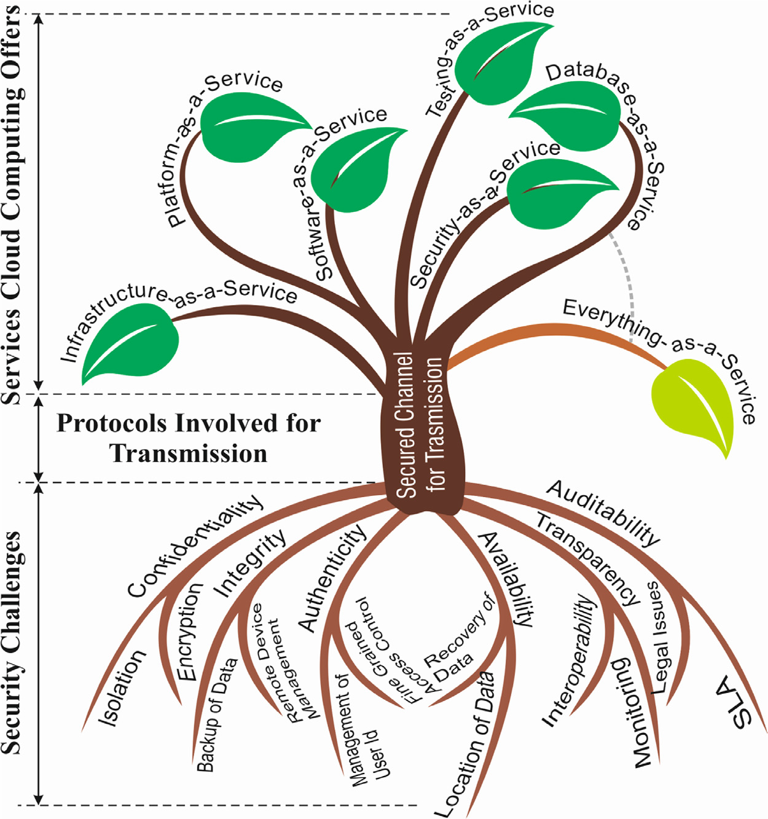

Slide 7
Cloud Computing threats, risks and security concern
From a safety point of view, there are several threats and risks that users encounter while transferring to and saving data in the cloud. Among all these threats, data breaching is identified as the topmost security issue.
Handling of data by third party
Cyber attacks
Insider threats
Government intrusion
Legal liability
Lack of standardization
Lack of support
Constant risk

Slide 8
Data breaches
Compromised credentials and broken authentication
Hacked interface and Application Program Interfaces
Exploited system vulnerabilities
Account hijacking
Malicious insiders
The Advanced Persistent Threat(APT) parasite
Permanent data loss
Inadequate diligence
Cloud service abuses
Denial-of-Service(DoS) attacks
Shared technology, shared dangers

Slide 9
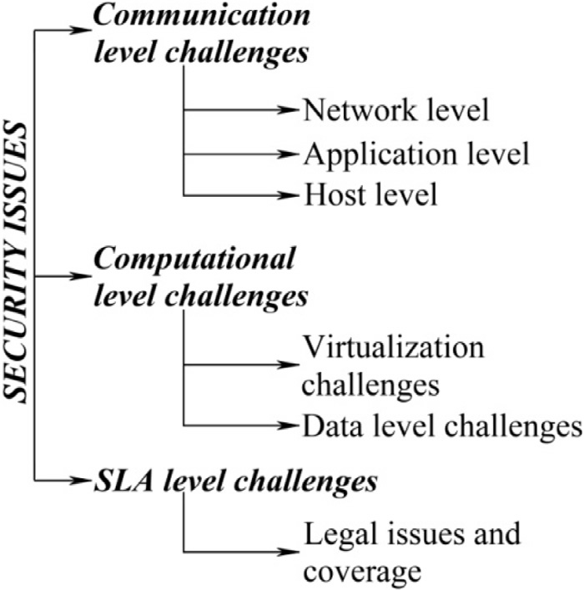
Classification of security issues

Slide 10
1.1 Communication level
Communication level issues arise as a result of the sharing of common resources, infrastructure, etc., among the Virtual Machines(VM's) becoming the target of attack.

Slide 11
Security in network level
The key features that should be addressed at the network level are confidentiality and integrity of data.
The issues with respect to network level security are:
Domain Name Server Attacks: Some of the most common types of DNS attacks are the DDoS attack, DNS rebinding attack, cache poisoning, Distributed Reflection DoS attack, DNS Tunneling, DNS hijacking, basic NXDOMAIN attack, Phantom domain attack, Random sub domain attack, TCP SYN Floods, and Domain lock-up attack.
Prefix Hijacking in Border Gateway Protocol:
Issue of Reused IP Addressing:
Sniffer Attacks etc.

Slide 12
Security in application level
Applications need security to avoid providing opportunities for attackers to gain control over them with their attempt to change their formats. The issues to be addressed at this level are:
• Cookie Poisoning;
• DDoS;
• Hidden Field Manipulation;
• Dictionary Attack;
• Google Hacking;
• CAPTCHA Breaking etc.

Slide 13
Security at host level
Host threats are addressed at the operating system level upon which applications work. The major host level threats are:
• Viruses, Trojan horses, and worms;
• Profiling;
• Password cracking;
• Footprinting;
• Denial of service;
• Unauthorized access.

Slide 14
1.2 Computational level
Implementation of the concept of virtualization in the cloud is one of the biggest computational level challenges.

Slide 15
Virtualization challenges
Abstraction of the physical resources is Virtualization.
Some of the common classes of virtualization are application virtualization, desktop virtualization, Network virtualization, Server and Machine virtualization.
VM level (Virtual layer) security challenges
The VMs undergo their own life cycles through different states like creation, pending, running, suspended, resumed, power-off, shutdown, destroyed, etc.

Slide 16
VM cloning
Creation of a copy of an existing VM with the same identifier (ID), computer name, Internet Protocol (IP) address and Media Access Control (MAC) address is called VM cloning.
The original VM called the parent shares the virtual resources with the cloned VM.
Any changes made to the parent after cloning does not affect the cloned VM and vice-versa.
If both the VM's run on the same network, security issues arises as the result of the duplication of IP address.

Slide 17
VM isolation
The VMs should be isolated to ensure safety and security.
Isolation of VMs guarantees security for VM, even if another VM on the same physical host is compromised.
But VM isolation is not the perfect solution when the hypervisor is compromised.

Slide 18
VM migration
VM's can be migrated from one server to another easily for improving the utilization of resources effectiveness.
This process can be automated for achieving load balance and energy saving.
This dynamic nature of the migration leads to security risks, not only to the migrated VM, but also for the new VM host.
The modes of migrations are live and non-live VM migration. Achievement of live migration is a complex task when compared with non-live migration.

Slide 19
Hypervisor level (Virtualization layer)
The use of a hypervisor for monitoring the life cycle of VMs, which includes creation, suspension, resumption and migration.
Hypervisor enables virtualization through resource pooling and multi-tenancy.
The most common approaches to hypervisor-based virtualization are para-virtualization. full-virtualization and hardware assisted virtualization.
Hypervisor-based virtualization suffers from Single-point-of-failure.
The challenges faced by the VMs in the hypervisor level are:

Slide 20
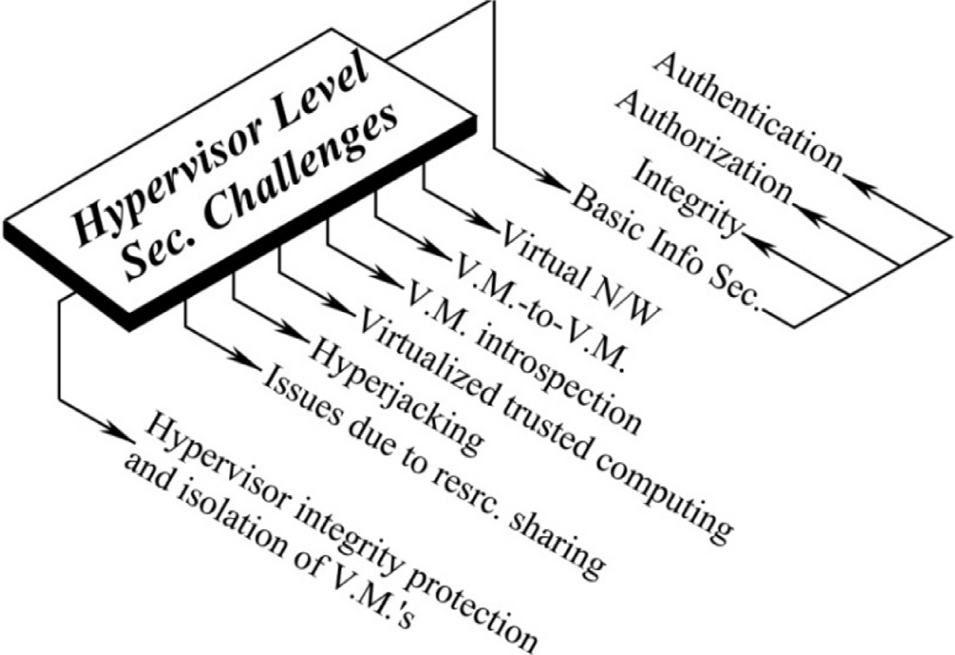

Slide 21
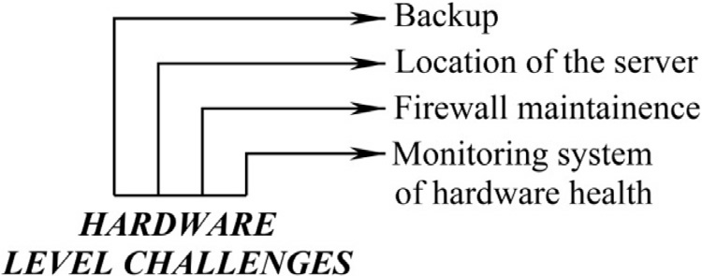
Hardware level (Physical layer)

Slide 22
Data level challenges
Data level security on the whole can be classified as data-in-transit and data-in-rest.
Data-in-transit does not lead to additional security risks when compared with data-in-rest, because, the transmission of data is done by default through TLS which provides a secured way of data transfer.
From the hacker's view point data-in-rest is more attractive

Slide 23
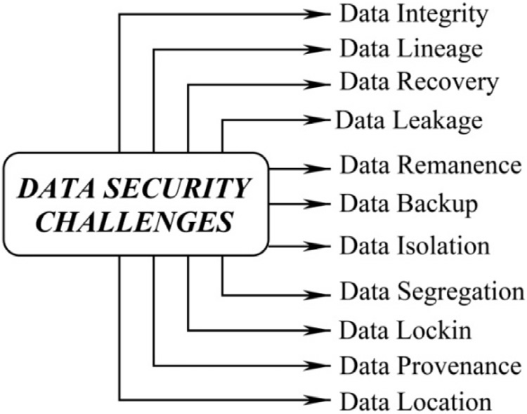
Data level challenges

Slide 24
Data in-transit
Data in-transit takes place among the entities in the crypto-cloud. The communication among the entities with a secured communication channel like Transport Layer Security, may give rise to the following issues taking place.
Data Leakage: Once the data is accessed by multi-tenant, the issue of data leakage arises.
As early as in March 2009, pointed out to the presence of a serious leakage of a user's private data, due to inherent security vulnerabilities in Google Docs.
The danger of data leakage is substantial, requiring careful handling.
Some of the challenges related to data leakage are, Instance Messaging, Email, Web Mail, Blogs / Wikis, Malicious, Web Pages, File Transfer Protocol (FTP) and Universal Serial Bus(USB)/ Mass storage device.

Slide 25
Data- in-rest
Data Recovery: The process of accessing data which is corrupted/damaged from the storage media is known as data recovery.
Data isolation: There should be a perfect separation between non-sensitive and sensitive data. Data should be isolated from unauthorized users through use of access control and encryption schemes.
Data segregation: Segregation of data refers to full separation between the cloud users in a virtualized environment.
Data segregation is an issue that is raised due to multi-tenancy.
Cloud providers should use highly secured protocols and encryption algorithms to achieve data segregation.
Data Lock-in: Data Lock-in is the main obstacle to achievement of portability and interoperability. The lock-in nature makes integration of data from different locations a difficult job

Slide 26
Data Location: Storage as a service is highly dependent on the location of the data.
Since the location of the data is not known to the users, users hesitate to store their sensitive data in the cloud.
It is one of the common issues faced by organizations.
The unknown location of data leads to questions of security, legal and requirements of regulatory compliance.
This is one of the challenging issues due to untrusted cloud service providers.

Slide 27
1.3 SLA Level
Services are to be offered by providers, to consumers with proper SLAs.
Basic entities of crypto-cloud have the responsibility of maintaining the SLAs.
Resource provisioning at any time depends on the bandwidth required, CPU, memory and key management amongst others.
Different levels of SLA's exist and they are customer-based, service-based and multi-level SLA.
There should not be any over/underestimation in the provision of the required resources.
The inclusion of security metrics in SLA is necessary for mitigating risks and for effective transfer of responsibility between parties.

Slide 28
There is no unique standard for SLA that applies to all security management needs.
But some standards like European Commission SPECS(Secure Provisioning of Cloud Services) and ENISA(European Network and Information Security Agency) provide security through the maintenance of SLAs.
The use of SLA helps to get a Quality of Service (QoS) upto an acceptable level.
SLA includes contract definition, negotiation, monitoring and enforcement.
Contract definition and negotiation, identifies the benefits and responsibilities of each party.
Monitoring and enforcement build a trust between the consumer and the provider.

Slide 29
Tools used in Cloud Security
Some of the tools used in cloud security are:
Qualys
White Hat security
Okta
Proofpoint
Zscaler
DocTrackr
Vaultive

Slide 30
Cloud Security Design Principles
The major security design principles of Cloud computing are:
Least Privilege
Separation of Duties
Defence in Depth
Defence in Multiple Places
Layered Defences
Security Robustness
Deploy KMI/PKI
Deploy Intrusion Detection Systems
Fail-safe
Economy of Mechanism
Complete Mediation
Leveraging Existing Components

Slide 31
Legal Matters in Cloud Computing
A data center may face the interruption or damage from terrorist attacks, earthquakes, fires, floods, computer viruses, telecommunication failures, power loss, computer denial of service attacks, and other efforts to damage systems. The provider must have redundant servers and remote back-ups of data for ensuring the continuity of service in such cases.
In case services are disturbed or data is lost, the service provider must afford the expenses and costs incurred by the consumer.
Various nations have privacy laws that confine the personal information transfer outside their borders.

Slide 32
Legal Matters in Cloud Computing
If personal information from one jurisdiction is processed or stored on a server in other location, the consumer will be required to abide with the legal regulations in the nation from where the data is transferred.
In case of any disagreement by the service provider, the customer should at least make sure that the contract has a proper optional dispute resolution mechanism such as mediation or arbitration, for minimizing the risk of being drawn into expensive litigation in a foreign nation.

Slide 33
Thank You!

Slide 34
Advanced Technologies in Cloud Computing
Internet of Things (IoT)
Cloud of Things (CoT)
Fog/Edge Computng
Mobile Cloud Computing
Green Computing

Slide 35
Internet of Things (IoT)
Any smart system who is connected to internet could be IoT.
An IoT device is a piece of hardware with a sensor that transmits data from one place to another over the Internet.
The Internet of Things (IoT) is the network of physical objects—devices, vehicles, buildings and other items—embedded with electronics, software, sensors, and network connectivity that enables these objects to collect and exchange data
IoT devices include wireless sensors, software, actuators, and computer devices.
They can be embedded into mobile devices, industrial equipment, environmental sensors, medical devices, and more.
The definition of IOT changes as the time of cloud computing comes. It is now defined as:
IOT=cloud computing + ubiquitous network + intelligent sensing network.
Notes:
35

Slide 36
The key technologies of IoT
Radio-Frequency Identification (RFID): The RFID is the technology that uses radio waves to detect, identify and track an object electronically through a tag attached to the object.
It can store and/or retrieve information using electromagnetic transmission and a radio frequency (RF) compatible integrated circuit.
A simple RFID system consists of RFID readers and RFID tags.
Wireless Sensor Network (WSN): A sensor is a device that is able to detect a certain type of input from the physical object or the environment such as heat, smoke, light, motion, and pressure.
The output of a sensor is an electrical signal that is transmitted to the data center for processing and extracting knowledge.
WSN is a group of sensors that communicates wirelessly and hop-by-hop to gather information and to detect a certain event in a physical environment
Notes:
36

Slide 37
The key technologies of IoT
It faces many challenges in terms of communication and resource constraints such as short communication range, mobility, reliability, and security.
Addressing: The development of the Internet has led to interconnect objects and intelligent systems.
In this case, identifying and managing objects are very essential for IoT, as it consists of a large number of objects.
Addressing adds more features to IoT, which are uniqueness, reliability, persistence, and scalability.
Middleware: The middleware and application layer, with the main objectives of functional abstraction and device communication plays a key role due to the heterogeneous objects , limited storage, and processing capabilities.
The middleware is categorized in layers such as object abstraction, service management, service composition and applications.
Notes:
37

Slide 38
Characteristics of IoT
Connectivity: IoT devices and connected hardware and control systems used internet for connectivity as well as to interact with each other.
Things: Any device that is designed to be connected on internet can be tagged as things. It may vary from sensors, household applications to tagged livestock. Devices such as sensors and other sensing materials can be attached to items.
Data: Data is useful information that is exchanged between the devices. It can be both in raw form or processed information.
Communication. Devices get connected so they can communicate data and this data can be analysed. This communication can occur over short distances as well as long range. For example: LPWA (such as NB-IoT),Wi-fi etc.
Notes:
38

Slide 39
Characteristics of IoT
Intelligence. Intelligence refers to the sensing capabilities of IoT devices and the intelligence is usually calibrated with the help of big data analytics (also known as artificial intelligence).
Action. This is the final output of intelligence. This can be manual action, action based upon debates i.e. information based upon exchange of information between embedded devices (for example smart factory decisions) and automation.
Ecosystem. The various devices that are connected over internet are comprises the IoT ecosystem. The transfer of data takes place between different devices on smart environment through cloud computing and Big Data.
Notes:
39

Slide 40
Applications of IoT
Wearables:
Virtual glasses, fitness bands to monitor for example calorie expenditure and heart beats, or GPS tracking belts, are just some examples of wearable devices that we have been using for some time now.
Health
The use of wearables or sensors connected to patients, allows doctors to monitor a patient's condition outside the hospital and in real-time.
Through continuously monitoring certain metrics and automatic alerts on their vital signs, the Internet of Things helps to improve the care for patients and the prevention of lethal events in high-risk patients.
Traffic monitoring
The Internet of things can be very useful in the management of vehicular traffic in large cities, contributing to the concept of smart cities.
Notes:
40

Slide 41
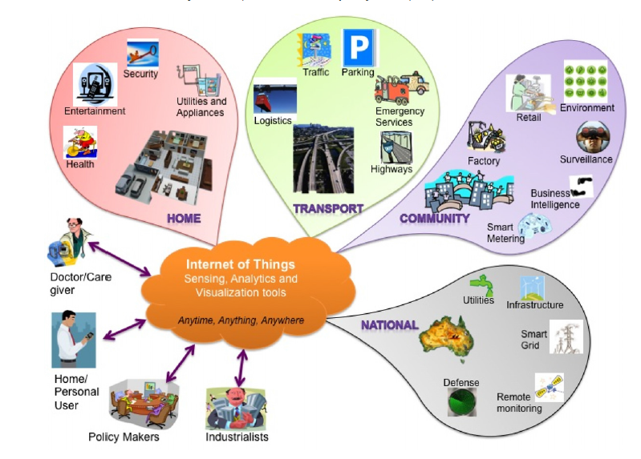

Slide 42
Applications of IoT
When we use our mobile phones as sensors, which collect and share data from our vehicles through applications such as Waze or Google Maps,
we are using the Internet of Things to inform us and at the same time contribute to traffic monitoring, showing the conditions of the different routes, and feeding and improving the information on the different routes to the same destination, distance, estimated time of arrival.
Fleet management: The installation of sensors in fleet vehicles helps to establish an effective interconnectivity between the vehicles and their managers as well as between the vehicles and their drivers.
The application of the Internet of Things to fleet management assists with geolocation, performance analysis, telemetry control and fuel savings, the reduction of polluting emissions to the environment and can even provide valuable information to improve the driving of vehicles.
Notes:
42

Slide 43
Applications of IoT
Agriculture: The quality of soil is crucial to produce good crops, and the Internet of Things offers farmers the possibility to access detailed knowledge and valuable information of their soil condition.
Through the implementation of IoT sensors, a significant amount of data can be obtained on the state and stages of the soil.
Information such as soil moisture, level of acidity, the presence of certain nutrients, temperature and many other chemical characteristics, helps farmers control irrigation, make water use more efficient, specify the best times to start sowing, and even discover the presence of diseases in plants and soil.
Hospitality: The application of the IoT to the hotel industry brings with it interesting improvements in the quality of the service. With the implementation of electronic keys, which are sent directly to the mobile devices of each guest, it is possible to automate various interactions.
Notes:
43

Slide 44
Applications of IoT
Smart grid and energy saving: The progressive use of intelligent energy meters, or meters equipped with sensors, and the installation of sensors in different strategic points that go from the production plants to the different distribution points, allows better monitoring and control of the electrical network.
Water supply: A sensor, either incorporated or adjusted externally to water meters, connected to the Internet and accompanied by the necessary software, helps to collect, process and analyze data, which allows understanding the behavior of consumers, detecting faults in the supply service, report results and offer courses of action to the company that provides the service.
Maintenance management: One of the areas where the application of IoT technology is most extensive is precisely maintenance management. Through the combination of sensors and software specialized in CMMS/ EAM maintenance management, a multifunctional tool is obtained whose use can be applied to a multiplicity of disciplines and practices, with the purpose of extending the useful life of physical assets, while guaranteeing asset reliability and availability.
Notes:
44

Slide 45
Challenges of IoT
Power management
Connectivity
Complexity
Energy efficiency
Security mechanism
Data handling
Simplicity

Slide 46
Limitation
IoT devices has limited capability of computation and storage, so we need services of cloud.

Slide 47
Integration of Cloud with IoT (CoT)
The data generated by the IoT enabled devices is of enormous amount where it becomes difficult to perform analysis on physical systems.
Hence, to store, process and analyze this it demands the services of cloud. So, this IoT and cloud computing integration is referred to as Cloud of Things.
The Cloud of Things collects the sensor data of your connected machines in real-time and analyzes it.
It makes extremely easy to develop new business models, increase the efficiency of your systems and processes, reduce downtime and cut costs through predictive maintenance.
It also benefits one by having limited capacity and storage, improved performance, reduced overall cost.
Notes:
47

Slide 48
Number of connected devices has already exceeded the number of people on Earth.
Already, connected devices have reached 9 billion and are expected to grow more rapidly and reach 24 billion by 2020.
By 2025, the IoT trends suggest the number will rise to 75 billion devices.
Number of connected devices is rapidly increasing, so there is going to be a lot of data as well.
Storing that data locally and temporarily will not be possible any more. There is going to be a need of rental storage space.
Also, this huge amount of data must also be utilized in the way it deserved.
Notes:
48

Slide 49
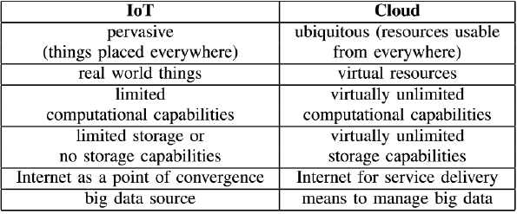
Cloud with IoT
Notes:
49

Slide 50
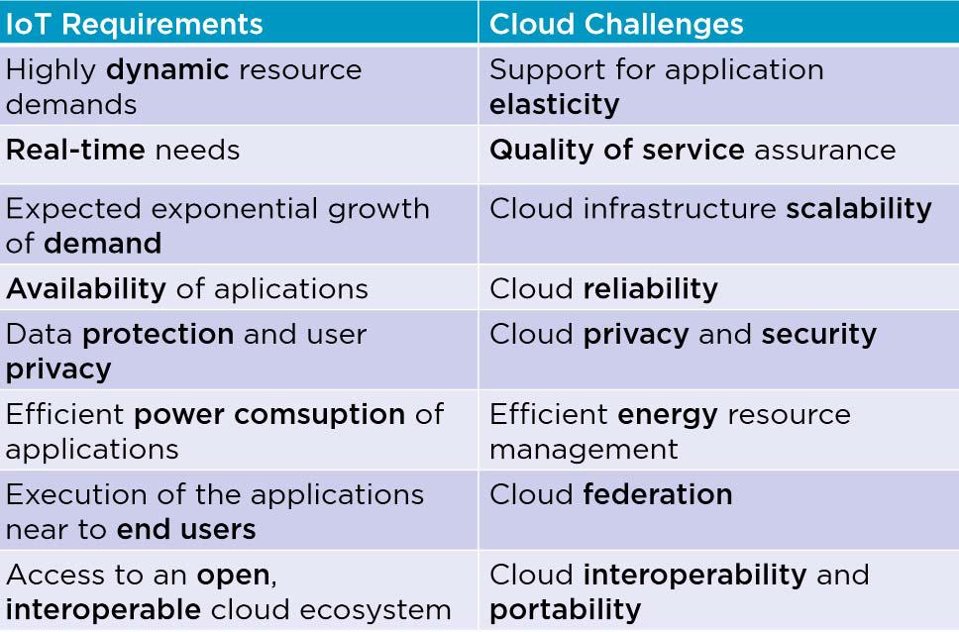

Slide 51
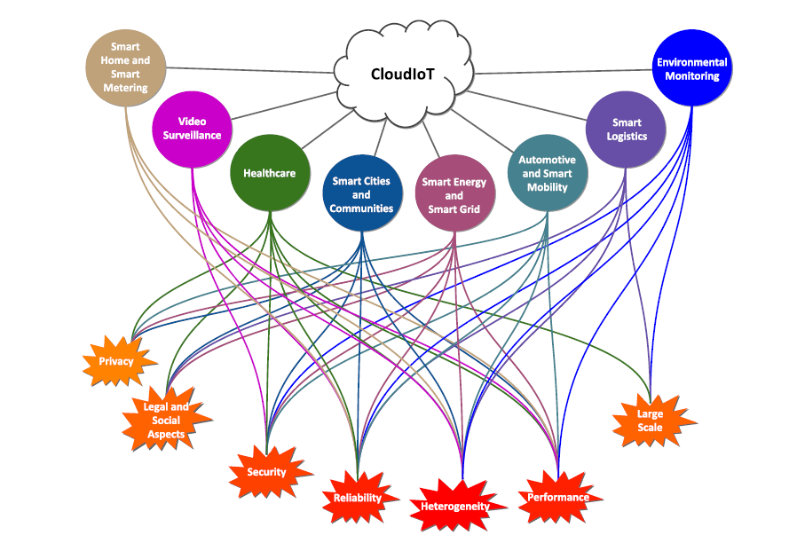

Slide 52
Applications of CoT
Healthcare: The adoption of the CoT paradigm in the healthcare field can bring several opportunities to medical IT, and experts believe that it can significantly improve healthcare services and contribute to its continuous and systematic innovation.
Smart cities and communities: CoT leads to the generation of services that interact with the surrounding environment, thus creating new opportunities for contextualization and geo-awareness. Sustainable development of urban areas is a challenge of key importance and requires new, efficient, and user-friendly technologies and services.
Smart home and smart metering: Home networks have been identified as the environment where users mainly act: CoT has large application in home environments, where the joint adoption of heterogeneous embedded devices and Cloud enables the automation of common in-house activities.
Notes:
52

Slide 53
Applications of CoT
Video surveillance: CoT in the context of intelligent video surveillance leads to easily and efficiently store, manage, and process video contents originating from video sensors (i.e. IP cameras) and to automatically extract knowledge from scenes. It has become a tool of the greatest importance for several security related applications.
Agriculture
Academic
Industry
Smart Home
Smart Transportation
Notes:
53

Slide 54
Issues or challenges with CoT
Protocol supports
Energy Efficiency
Resource Allocation
Identity Management
IPv6 deployment
Service discovery
Quality of Service provisioning
Location of data storage
Security and privacy
Unnecessary Communication of data
Heterogeneity
Notes:
54

Slide 55
Limitation of cloud services
Depends on internet connection: The internet is the only way to access the services of cloud computing.
Risk of data confidentiality: There is always a risk that user data can be accessed by other people. So data and cloud protection must be good because if it won’t be dangerous for data confidentiality.
Loss of Control: You are, essentially, trusting another party to take care of your data. You are trusting that they will maintain their data centers and servers.
Latency: Managing Big Data applications exclusively in the cloud is not an efficient solution for latency-sensitive applications related to smart transportation systems, healthcare
solutions, emergency response systems and content delivery applications.
Energy: Transport network consume more energy in cloud.
Notes:
55

Slide 56
Fog/Edge:Emerging Technologies to overcome the limitations of CoT
Fog is closer to end-users.
Fog is the extension of cloud computing that consists of multiple edge nodes directly connected to physical devices.
Fog computing is a decentralized computing infrastructure in which computing resources are located between the data source and the cloud.
Fog server has hardware and operating system and acts processing unit.
It is responsible for receiving all data originated from the sensors and process by applying compression and encryption, if needed.
It is responsible for collecting and processing data originated from the sensors and equipment connected via wireless networks, such as Wi-Fi.
After processing the received data from the sensors, sent to cloud for permanent storage.
Any device with computing, storage, and network connectivity can be a fog node. Examples switches, routers, embedded servers, and mobile.
Notes:
56

Slide 57
Comparison between Cloud and Fog
Parameters/Attributes | Cloud | Fog
Architecture | Centralized | Distributed
Communication with devices | From a distance | Directly from the edge
Response time | Minutes, day | Millisecond, second
How long IoT data is stored | Months or years | Transient storage, often 1–2 hours
Data processing | Far from the source of information | Close to the source of information
Computing capabilities | Higher | Lower
Number of nodes | Few | Very large
Latency | High | Low
Connectivity | Internet | Various protocols and standards

Slide 58
Advantages of Fog node
Latency: Fog paradigm allows the placement of a processing unit closer to devices/sensors. Thus, the overall latency can be significantly reduced since the physical distance is shorter.
Energy: By offloading tasks in the Fog rather than in Cloud, reduced approximately 40% of energy.
Security Concerns: All IoT applications must be secure. Any security breach may expose the system to a malicious software that could cause severe consequences.
In Fog architecture, IoT devices and sensors are connected to the Fog devices which are located in close proximity to the users and it is also responsible for intermediate computation and storage.
Notes:
58

Slide 59
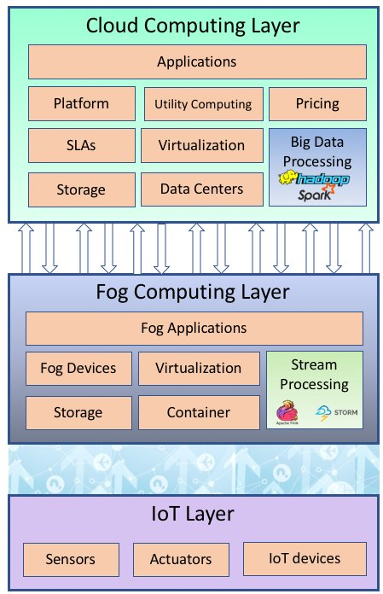
Architecture for processing the data in IoT environment
Notes:
59

Slide 60
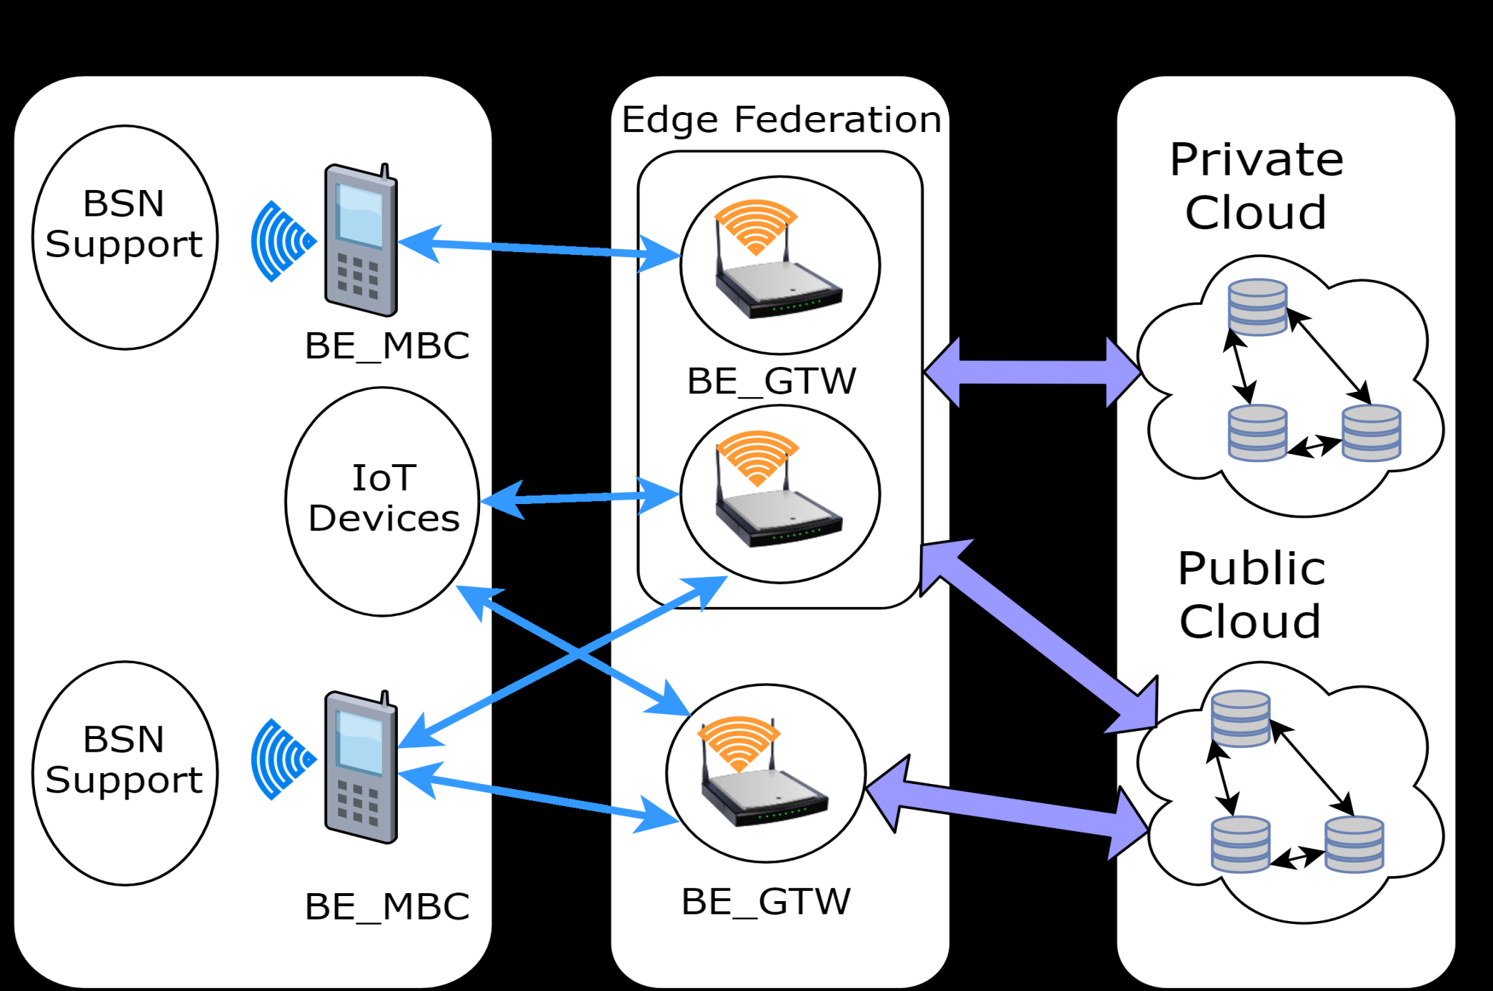


Slide 61
Fog computing drawbacks
Due to its heterogeneity, Fog nodes can not guarantee the resources from a particular fog node will be the same in all fog nodes.
The same reliability in Fog networks demand much more effort, regarding complexity and cost, than in cloud systems.
A single Fog node can introduce malicious software or make the system work incorrectly.
One more issue to pay close attention in Fog nodes is the network connectivity among nodes.
If a single node loses connectivity with the network, even if its hardware is fully functioning, the whole system may be compromised.
Notes:
61

Slide 62
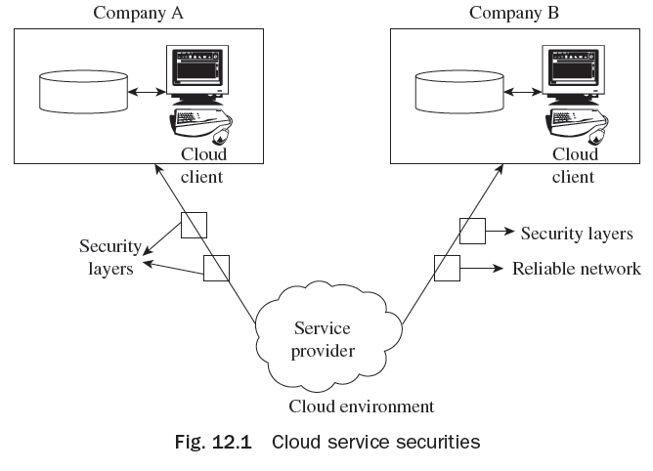
Cloud Computing Trends
Cloud Computing is a progressive technology and the several trends recognized by analysts and professionals are:
High Commercial Importance
Hybrid Cloud Computing
Dedicated Cloud Applications for Mobile
Cloud Computing Information Security

Slide 63
Understanding Cloud Tools
A company that provides tools for cloud development is CollabNet, which has focused products and services.
CollabNet offers clients various opportunities to join and makes an announcement every time with new style about how to access tools and better features.
Hybrid cloud IT is adopted by CollabNet for various application development and deployment life cycles.

Slide 64
Understanding Cloud Tools
For managing and monitoring cloud computing, various tools are available, some of which are as follows:
AppDynamics
Nimsoft
ManageEngine
NetEnrich
NetRelic
Rackspace
SplunkStorm
Aternity
Compuware Gomez

Slide 65
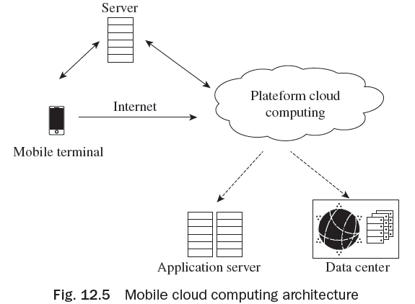
Mobile Cloud Computing
Mobile cloud computing (MCC) is the integration of mobile network computing, wireless networks, and cloud computing used to develop rich applications for mobile users.
MCC provides mobile users with processing
services and data storage in clouds.
The architecture of mobile cloud computing is
shown in Fig. 12.5.
The various contemporary systems which
have similar goals of web-based operating
system are EyeOS, HP Palm OS, Open Mobster.

Slide 66
Mobile Cloud Computing
Advantages of MCC:
Flexibility
Real time application
Multiple platform support
Low cost option
Disadvantages of MCC
Data security
Performance issues and connectivity

Slide 67
Mobile Cloud Computing
Mobile Cloud Computing (MCC) Applications are:
Cloud based m-learning
Mobile e-governance
Mobile banking
Guidance with the help of mobile
Cloud-based mobile rural healthcare
Gaming with mobile
Mobile e-commerce

Slide 68
Cloud Descriptor Language
Cloud descriptor language uses the feature of XML like schema exchange.
Cloud descriptor language sometimes uses scripting language for it
application.
Scripting languages are C++, Python, Perl etc.

Slide 69
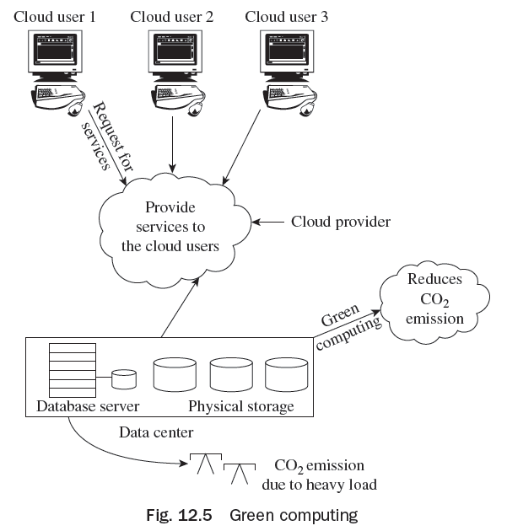
Green Computing
‘Green computing’ is used to signify the effective use of resources in
computing.
This word usually associates to the use of
computing resources in concurrence with
augmenting financial feasibility, shrinking
environmental effect, and guaranteeing social
responsibilities.

Slide 70
Third Party Technology
Beneath the cloud model, the software is operated online by a third-party supplier, and one can access it via Internet browser.
Third-party concept is also very valuable in providing security to the cloud data center.
Operating software online also has several built-in advantages:
Work from wherever you want
Collaborate with customers, dealers, and contemporaries
Limit threat of catastrophe and expedite catastrophe recuperation

Slide 71
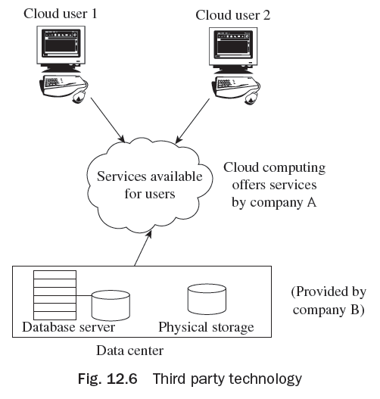
Third Party Technology
Examples of Third Parties:
Dropbox, a SaaS vendor, uses the services of a third-party IaaS vendor, like
Amazon Web Services.
In Fig. 12.6, company A offers various exciting
services to the users but for the physical storage
of data, company A involves third-party company
B. Users are unaware of the services of company
B because they know that they are taking services
from company A.

Slide 72
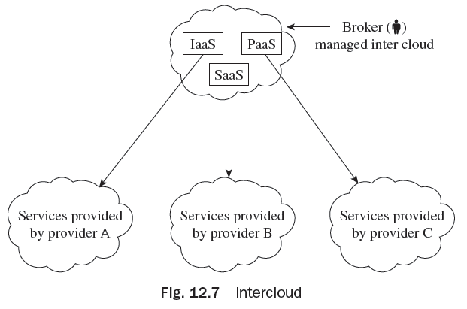
Intercloud
The Intercloud is a unified universal ‘cloud of clouds’ and an expansion of the Internet ‘network of networks’ on which it is established.
The Intercloud circumstances are based on the chief concept that every individual cloud does not contain countless physical resources or ubiquitous geographic marks.
As shown in Fig. 12.7, the broker offers three
facilities to the cloud users, such as SaaS, PaaS,
and IaaS. IaaS services are offered by cloud provider
A, SaaS services by cloud provider B, and PaaS
services are offered by cloud provider C.

Slide 73
Thank You!

